Slide 1






Enhanced environmental protection inspection for efficient control of air quality monitoring and of all entities under obligation within system of greenhouse gas emission allowance trading, in order to achieve better quality of air in Republic of Croatia
This project is funded by the European Union

Slide 2



THEME 1: Pollution of the atmosphere

Slide 3

1.4 METEOROLOGICAL FACTORS
European Union IPA 2013 Programme for Croatia
Factors that affect the distribution of pollutants in the air as well as on the transport over long distances are:
ATMOSPHERIC STABILITY
The horizontal circulation (wind-speed and direction)
Vertical circulation (turbulence)
AIR MASSES
THE ATMOSPHERIC FRONTS
PRECIPITATION
AIR TEMPERATURE

Slide 4
1.4 METEOROLOGICAL FACTORS
European Union IPA 2013 Programme for Croatia
The differences in the warming of the Earth's surface
The differences in the warming of the Earth's surface are the basis for the creation of the wind according to the following scheme:
DIFFERENCES IN TEMP. SURFACE
DIFFERENCES IN ATM. PRESSURE
ATM. ADJUSTING PRESSURE
CREATION OF THE WIND

Slide 5
1.4 METEOROLOGICAL FACTORS
European Union IPA 2013 Programme for Croatia
The differences in the warming of the Earth's surface
The energy received from the Sun absorbs the Earth's surface to varying degrees.
Example:
The land is absorbed and stored energy different from the water. Dry surface heated and cooled faster than the water surface, while the water surface will heat and cool more slowly than the land for several reasons:
• constant movement of water distributed the heat
• The Sun's rays penetrate through the surface of the water and thus warm the water to a certain depth

Slide 6
1.4 METEOROLOGICAL FACTORS
European Union IPA 2013 Programme for Croatia
• due to the different thermal capacity, requires a greater amount of energy to heat water in relation to the same mass of soil
• water evaporation process cools the water surface.
The different types of land surfaces have different ability of absorption and storage energy.
Color, shape, texture of the surface, vegetation and vicinity to buildings affect the warming and cooling the soil.

Slide 7
1.4 METEOROLOGICAL FACTORS
European Union IPA 2013 Programme for Croatia
The sandy coast, roads and buildings are quickly become warm during the day, resulting in a higher temperature of the air above them
The area under the vegetation (forests and meadows) heat up more slowly, and the air temperature over them is lower
During the night, the situation is reversed.

Slide 8
1.4 METEOROLOGICAL FACTORS
European Union IPA 2013 Programme for Croatia
Heat transfer
Heat energy in the atmosphere, except the radiation spreads in processes:
Conduction is the spontaneous transfer of heat energy through matter from areas of higher temperatures in the area of the lower temperatures, and therefore it acts for the purpose of compensating for temperature difference.
CONDUCTION CONVECTION ADVEKCTION

Slide 9
1.4 METEOROLOGICAL FACTORS
European Union IPA 2013 Programme for Croatia
Example of conduction:
Heated ground heats the air conduction.
Convection is the directed motion, i.e. fluid flow (liquid and gas), where the hotter fluid moves according to the colder and transfers the warmth of the area.
Example of convection:
Heated air, since it is lighter than the surrounding cold air, raises up and transfers the heat vertically by convection.

Slide 10
1.4 METEOROLOGICAL FACTORS
European Union IPA 2013 Programme for Croatia
Advection is the horizontal heat transfer between the individual parts of the Earth.
Example: Advection
Heat transfer in horizontal air currents

Slide 11
1.4 METEOROLOGICAL FACTORS
European Union IPA 2013 Programme for Croatia
Atmospheric circulation
Motion of air masses occurs due to efforts to make equal air pressure in different areas. Imbalance in air pressure occurs as a result of the different insolation and different heating of the Earth's surface.
Atmospheric circulation is extremely important factor to the distribution of pollutants in the air.

Slide 12
1.4 METEOROLOGICAL FACTORS
European Union IPA 2013 Programme for Croatia
Atmospheric circulation (wind)
Air flow is one of the basic characteristics of the atmosphere, and the wind as the horizontal component of the flows of atmospheric air in relation to the Earth's surface is an essential element in the general circulation of the atmosphere.
Wind is the vector and determines its direction and speed, and marks that side of the world from where the wind is blowing:
The North wind always blow from the North in the direction of the South!

Slide 13
1.4 METEOROLOGICAL FACTORS
European Union IPA 2013 Programme for Croatia
The wind also affects the force of the pressure gradient, which occurs due to the differences in pressures. The air moves from area of higher in the area of lower air pressure.
Pressure gradient is described by the following equation:
pressure gradient = pressure difference/distance

Slide 14
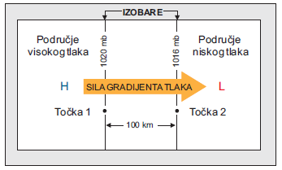
1.4 METEOROLOGICAL FACTORS
European Union IPA 2013 Programme for Croatia
Example:
The schematic diagram shows the pressure gradient force between Point 1 in the High Pressure Range (1020 mb) and Point 2 in the Low Pressure Range (1016 mb). The distance between the points is 100 km and the pressure gradient is 4 mb at 100 km.
ISOBARS
High pressure area
Low pressure area
pressure gradient force
POINT 1
POINT 2

Slide 15
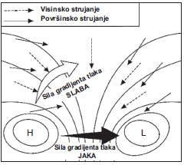
1.4 METEOROLOGICAL FACTORS
European Union IPA 2013 Programme for Croatia
If the pressure on a small horizontal distance is large, and the isobars on weather maps "condensed", there will be big pressure gradient force and strong wind.
Conversely, if the isobars are spaced, the pressure gradient is small, and the wind is weak.
WEAK WIND
STRONG WIND

Slide 16
1.4 METEOROLOGICAL FACTORS
European Union IPA 2013 Programme for Croatia
Systems of local winds
The physical characteristics of the Earth's surface under the common name of the topographical elements cause a thermal and mechanical air circulation.
Thermal circulation is a consequence of different heating surface which occurs because of the different types of surfaces absorb differently and variously released warmth in the air at the ground.

Slide 17
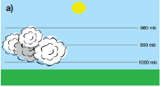
1.4 METEOROLOGICAL FACTORS
European Union IPA 2013 Programme for Croatia
The generation of thermal circulation
This figure shows a situation in which there is no pressure or temperature gradient, so therefore there is no phenomena of the wind. Atmospheric pressure decreases with height (1000 to 980 mb).

Slide 18
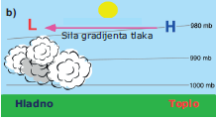
1.4 METEOROLOGICAL FACTORS
European Union IPA 2013 Programme for Croatia
The generation of thermal circulation
pressure gradient force
COLD
WARM
On the right is visible the warming of the soil which transfers the heat to the air over the area. The warm air rises and isobar spacing increases. In the upper parts of the atmosphere pressure gradient occurs and the air begins to move to the left, according to the area of lower pressure.

Slide 19
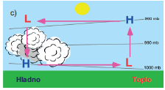
1.4 METEOROLOGICAL FACTORS
European Union IPA 2013 Programme for Croatia
The generation of thermal circulation
COLD
WARM
This picture shows complete air circulation. At a time when warm air arrives above the clouds, it cools and pounds. Now underneath the cloud creates higher air pressure that drives the air to the right due to the pressure gradient force. Such circulation is initiated by uneven warming of the Earth's surface.

Slide 20
1.4 METEOROLOGICAL FACTORS
European Union IPA 2013 Programme for Croatia
The generation of thermal circulation
Mechanical circulation occurs due to winds blowing over of topographic elements of different shapes and heights. There are four topographic categories that have the most influence on the thermal and mechanical circulation:
plain
mountain/valley
land/sea
urban area

Slide 21
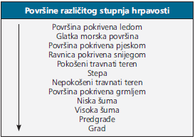

1.4 METEOROLOGICAL FACTORS
European Union IPA 2013 Programme for Croatia
Plain
Plain is a typical terrain which mechanical air circulation depends on the amount of natural or human hand created prominence due to the influence of the friction.
SURFACE OF DIFFERENT ROUGHNESS
List of area of different degrees of roughness. At the top of the list are the smooth surface with the smallest impact on the friction, and toward the end of the list the roughness increases, and with it the friction.
The area covered by ice
Smooth sea surface
The surface is covered with sand
Plains covered with snow
Mown grass terrain
Steppe
Mown grass terrain
Non-mown grass terrain
Area under bushes
Low Forests
High Forests
Suburban
Urban
Institut za energetiku i zaštitu okoliša

Slide 22
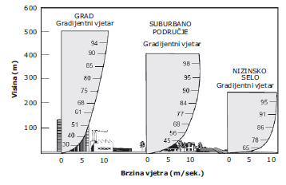
1.4 METEOROLOGICAL FACTORS
European Union IPA 2013 Programme for Croatia
Plain
The height and density of the vertical barrier intensifies the impact of friction on the speed of the wind, which results in a change of the profile of the wind with height.
Urban
Suburban
The picture shows an increase in wind speed with height for three basic types of terrain: a city with tall buildings, suburban area with low houses and the lowland village.
Village
Altitude
Wind speed
Institut za energetiku i zaštitu okoliša

Slide 23
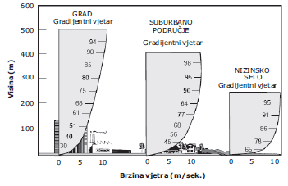
1.4 METEOROLOGICAL FACTORS
European Union IPA 2013 Programme for Croatia
Plain
Urban
Suburban
Village
Altitude
Wind speed
In the area of the city, due to friction, high buildings are slowing down the speed of the ground-level of the horizontal wind which then changes direction and comes to the TURBULENCE.
The turbulence was less pronounced in the suburban area, because the friction is less.
The turbulence was the least pronounced in the lowland village because of the least friction.

Slide 24
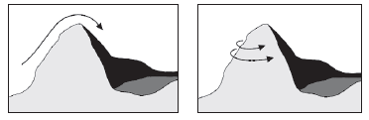
1.4 METEOROLOGICAL FACTORS
European Union IPA 2013 Programme for Croatia
Mountain/Valley
Mechanical air circulation in the topographic category Mountain/Valley is closely linked with the size, shape and orientation of the topographic element and because of this is different for each individual instance.
Despite of diversity, there are two main directions of the wind blowing in such area. One is the endeavor of the air masses to rise over an obstacle, and the other occurs in cases of temperature inversions (the top layer of air is warmer than the bottom) when mass rounds mountain.

Slide 25
1.4 METEOROLOGICAL FACTORS
European Union IPA 2013 Programme for Croatia
Mountain/Valley
Thermal circulation is also associated with the size, shape and orientation of the topographic and distinct element is given the time of day.
Heating will also be affected by vegetation, and the slopes that are harvested will be less heated from rocky slopes.

Slide 26
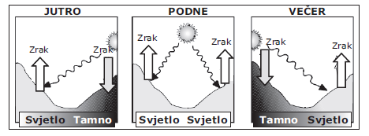
1.4 METEOROLOGICAL FACTORS
European Union IPA 2013 Programme for Croatia
Mountain/Valley
Because of the Sun's position on Earth's surface in the morning hours warms one side of the mountain, and the heated air above this slope rises as the cold air over the other unheated slope pounds. At noon, when the Sun is in a zenith, both sides of the slopes are heated as well as the air above them that is raised on both sides. In the evening the situation is reversed from the morning.
MORNING
NOON
EVENING

Slide 27
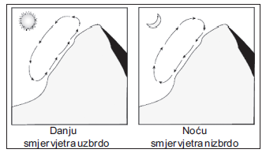
1.4 METEOROLOGICAL FACTORS
European Union IPA 2013 Programme for Croatia
Mountain/Valley
Due to the heating of the surface of the slope of the mountain during the day and cool at night, the wind is changing within a 24-hour period. During the heated air rises and air circulation is directed towards the top of the mountain, and at night the circulation reversed due to the cooling of air at night which plunges.

Slide 28
1.4 METEOROLOGICAL FACTORS
European Union IPA 2013 Programme for Croatia
Land/sea
Thermal characteristics of the land and sea are different.
The land and the buildings on it are heated and cooled relatively quickly
The sea is heated and cooled relatively slowly
Because of that, the water temperature does not vary substantially in a shorter period of time, but rather follows seasonal changes. This is because the solar radiation penetrates into the land only a few inches in depth, while in the water column penetrates much deeper.
That is why the release of heat from the mainland is larger, and with the surface of the water less. On the inferior water heating influence:
evaporation
mixing of surface and deep layers of water

Slide 29
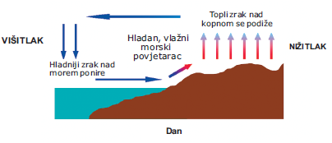
1.4 METEOROLOGICAL FACTORS
European Union IPA 2013 Programme for Croatia
Land/sea
Warmer air over land during the day is easier and is raised and at the altitude of approximately 400 m rotates towards the sea. Moving towards the sea, the warm air is cooled slowly and a bunch of above the sea, so as a heavier (the density of air is increased) begins to descend towards the sea. That the circulation was closed, it begins to blow the wind from the sea (sea breeze).
higher pressure
lower pressure
DAY

Slide 30
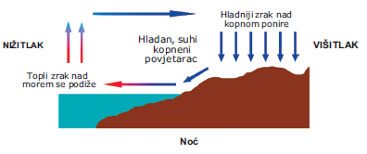
1.4 METEOROLOGICAL FACTORS
European Union IPA 2013 Programme for Croatia
Land/sea
At night, the situation is reversed. The land cools more quickly than the sea, so at night the temperature of the air above the sea is greater. Warmer air above the sea rising, moving to the land, so at night the wind's blowing from the land (land breeze).The difference between the temperatures of land and sea at night is much smaller than the daily temperature differences. Therefore, the wind from the land at night is weaker than a sea breeze.
lower pressure
higher pressure
NIGHT

Slide 31
1.4 METEOROLOGICAL FACTORS
European Union IPA 2013 Programme for Croatia
An urban area
The air over the urban area is warmer air from the natural environment and is such an area called heat island.
To this phenomenon occurs because the asphalt, concrete and urban structures absorb a greater amount of solar energy than the vegetation and soil. At night, the energy is slowly released which prevents the cooling air. In the urban centre wind is mainly weaker than in the surrounding area, and is also less evaporation.

Slide 32
1.4 METEOROLOGICAL FACTORS
European Union IPA 2013 Programme for Croatia
An urban area
Due to the heating of the air over cities, the atmosphere becomes unstable, which reinforces the high-altitude air currents that help in the formation of clouds and lightning.
In addition, due to the rise of hot air, especially at night, the area of the lower air pressure is created around the city as compared to the ambient air pressure outside the city so that light air flows from the environment toward the city.

Slide 33
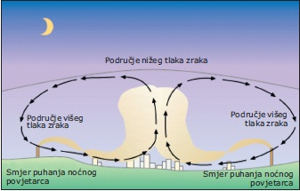
1.4 METEOROLOGICAL FACTORS
European Union IPA 2013 Programme for Croatia
An urban area
lower pressure
higher pressure
higher pressure
direction of blowing at night
direction of blowing at night
Such a situation favours the accumulation and retention of pollutants in the air over the city, and increases at the existence of a temperature inversion which prevents vertical mixing of layers of air.

Slide 34
1.4 METEOROLOGICAL FACTORS
European Union IPA 2013 Programme for Croatia
Air masses
Air masses are macroscale phenomena because they cover a large area of several thousand square feet and reaching a height of several thousand metres.
These are the relatively homogeneous air volumes that get their basic characteristics (temperature and humidity) in the area of origin, provided that they remain sufficiently long over this area to assume its characteristics. Air masses favor the spread of pollutants over long distances by distributing them to large areas.

Slide 35
1.4 METEOROLOGICAL FACTORS
European Union IPA 2013 Programme for Croatia
The atmospheric fronts
The atmospheric fronts are narrow border areas between atmospheric air masses of different properties.
If the air masses approach one another, the frontal zone narrows, the transition from one to the other air mass becomes sharper, the front becomes more pronounced, and this process is called frontogenesis.
If the air masses distancing, the frontal zone is widening, the differences in meteorological elements become less pronounced, the front gradually loses its importance and the process is called the frontolysis.

Slide 36
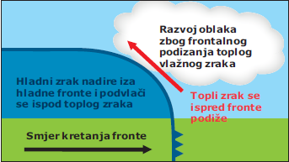
1.4 METEOROLOGICAL FACTORS
European Union IPA 2013 Programme for Croatia
The atmospheric fronts
According to the temperature characteristics of front sort on: cold
hot
stationary
ocluding
In the cold front the cold air reaches the warm area and comes to its "underlining" underneath the hot air. The reason is its higher specific weight. Due to the rise of the hot air in several layers, water vapor condensation and cloud formation occur.
The development of clouds by rising warm, moist air
The cold air hovers behind the cold front and dribbles under the warm air
The warm air rises in front of the front
Direction of front moving

Slide 37
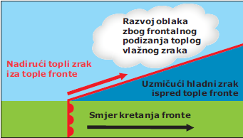
1.4 METEOROLOGICAL FACTORS
European Union IPA 2013 Programme for Croatia
The atmospheric fronts
In the warm front the warm air begins to reach the cold air, and because of its specific lightness, it "climbs" over the cold. Therefore, the boundary of the hot and cold air masses is inclined towards the cold air. Because of the hot air rising over the colder, condensation of water vapor is produced, ie the formation of cloudiness along the frontal surface.
Development of clouds due to hot humid air
The invading warm air behind a warm front
Pulling the cold air in front of the warm front
Direction of front moving

Slide 38
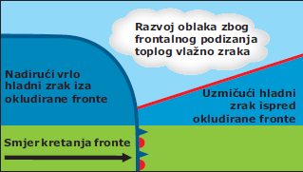
1.4 METEOROLOGICAL FACTORS
European Union IPA 2013 Programme for Croatia
The atmospheric fronts
Occluded front is created because the cold front is faster than hot, so after some time, four to five days on average, it will reach the warm front. The cold air will reach the cold air mass that the warm air was pushing in front of it. As a result, the warm air will be suppressed in height. As a result, the warm air will be suppressed in height. Now we have three air masses: two cold in the ground floor and one warm above them. Such a situation is called occlusion.
Development of clouds due to hot humid air
Invading very cold air behind the occluded fronts
Pulling cold air
Direction of front moving

Slide 39
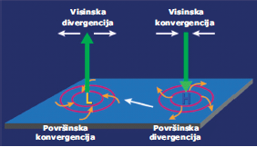
1.4 METEOROLOGICAL FACTORS
European Union IPA 2013 Programme for Croatia
Vertical air flow and atmospheric stability
Vertical circulation of air is important for the spread of pollutants as well as the horizontal flow (wind). Both the air flow are connected to each other in the following way:
To equalize surface convergence, the air moving towards the center of the low pressure zone (cyclone) rises slowly and at a height of about 6 km it begins to spread or diverge. As long as surface convergence and height divergence are in balance, the surface pressure in the center does not change.
Height divergence
Height convergence
Surface convergence
Surface divergence

Slide 40
1.4 METEOROLOGICAL FACTORS
European Union IPA 2013 Programme for Croatia
Vertical air flow and atmospheric stability
Height divergence
Height convergence
The influence of air pressure and vertical air flow on the wind
Surface convergence
Surface divergence
As the height divergence becomes larger than the surface convergence, the surface pressure in the center decreases. Such a situation increases the pressure gradient, and with it the force of the pressure gradient which enhances the strength of the surface winds.

Slide 41
1.4 METEOROLOGICAL FACTORS
European Union IPA 2013 Programme for Croatia
Vertical air flow and atmospheric stability
When high pressure (anticyclone) is found in the center of an area, surface winds are centered outwards (surface divergence). In order to equalize the air pressures, convergence occurs - lowering the air from the height to the surface.
With high currents in cyclone areas the air will be cooled and condensed, and descending in the anticyclone areas will heat up and overcome the brightly weather.
Height divergence
Height convergence
Surface convergence
Surface divergence

Slide 42
1.4 METEOROLOGICAL FACTORS
European Union IPA 2013 Programme for Croatia
Adiabatic change of temperature
An adiabatic temperature changes is an essential factor in determining the stability of the atmosphere.
In thermodynamics, adiabatic process is a process that takes place without the exchange of heat with the environment.
The term "adiabatic" literally means the absence of heat transfer. Generally, adiabatic processes cause a drop or rise in the temperature of the system.
Adiabatic cooling and adiabatic air heating are adiabatic processes in the atmosphere.

Slide 43
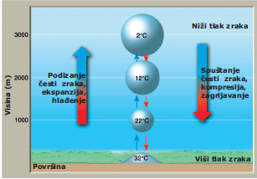
1.4 METEOROLOGICAL FACTORS
European Union IPA 2013 Programme for Croatia
Adiabatic change of temperature
When it is dry or moist air (but not saturated with water vapor) adiabatic rises, its temperature falls adiabatic. This dry air drop is 10°C every 1 km uphill.
Lower air pressure
Value of temperature drop in air at 1 ° C of 100 m height difference is called dry adiabatic cooling rate.
Raising air particles, expansion, cooling
Lowering air particles, compression, heating
Dry adiabatic rate (δa)
Higher air pressure

Slide 44
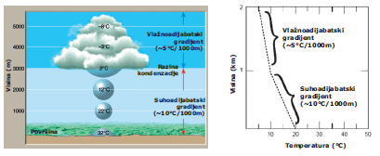
1.4 METEOROLOGICAL FACTORS
European Union IPA 2013 Programme for Croatia
Adiabatic change of temperature
By lifting and cooling the moist air particles away from the dew, the water vapor, which particle of air contains, begins to condense or sublimate. This releases a large amount of latent heat which reduces further cooling of frequent air.
As a result, the rising air particle temperature does not fall further by 1 ° C to 100 m, but by about 0.5 to 0.7 ° C per 100 m. In this case, the air is said to cool down by wet adiabatic and the temperature changes to the wet adiabatic rate. The height at which the rising air temperature rises to the dew point is called the condensation level.
Wet adiabatic
Wet adiabatic
Dry adiabatic
Dry adiabatic
Dry adiabatic and wet adiabatic rate

Slide 45
1.4 METEOROLOGICAL FACTORS
European Union IPA 2013 Programme for Croatia
Atmospheric stability
Depending on the vertical temperature gradient, the atmosphere can be located in one of the three equilibrium states:
stable
unstable
neutral

Slide 46
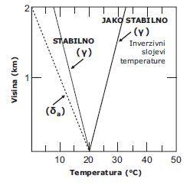
1.4 METEOROLOGICAL FACTORS
European Union IPA 2013 Programme for Croatia
Atmospheric stability
The atmosphere is stable when the vertical gradient of the temperature (γ) is lower than the adiabatic rate (δa), ie less than 1 ° C to 100 m in height difference. Stability is special when there are inverse layers in the atmosphere. In a stable atmosphere, weak horizontal flows and vertical downflows can occur, but vertical airflows can not occur from Earth's surface to height. Such a case occurs in anticyclones.
VERY STABLE
STABLE
Stable conditions in the atmosphere (γ < δa)
Temperature inversion
Altitude
Temperature

Slide 47
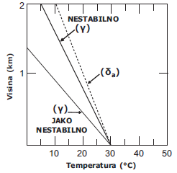
1.4 METEOROLOGICAL FACTORS
European Union IPA 2013 Programme for Croatia
Atmospheric stability
The atmosphere is unstable when the vertical gradient of the temperature is greater than the adiabatic, i.e. greater than 1 ° C to 100 m. Contrary to the previous case, vertical ascending streams occur in the unstable atmosphere. Such a case occurs in cyclone (depression).
UNSTABLE
Unstable conditions in the atmosphere(γ > δa)
Altitude
VERY UNSTABLE
Temperature

Slide 48
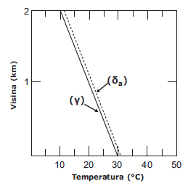
1.4 METEOROLOGICAL FACTORS
European Union IPA 2013 Programme for Croatia
Atmospheric stability
The atmosphere is neutral when the vertical gradient of the temperature is equal to the adiabatic gradient, ie equal to 1 ° C to 100 m in height difference. There are no conditions for any airflow.
Neutral conditions in the atmosphere (γ = δa).
Altitude
Temperature

Slide 49
1.4 METEOROLOGICAL FACTORS
European Union IPA 2013 Programme for Croatia
The influence of atmospheric stability on the plume of smoke
The dispersion of pollutants in the atmosphere depends on the physical condition of the atmosphere which includes:
the distribution of temperature in height
turbulence
the winds
One of the important indicators that characterized the state of the atmosphere is to change the temperature and air pressure with height.

Slide 50
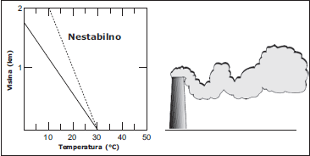
1.4 METEOROLOGICAL FACTORS
European Union IPA 2013 Programme for Croatia
The influence of atmospheric stability on the plume of smoke
looping plume occurs under strong convective conditions when the pollutant is caught in upward and downward curvature due to vertical motion of the air under unstable atmospheric conditions. Such a case is very advantageous for the dispersion of pollutants.
UNSTABLE
looping plume
Altitude
Temperature

Slide 51
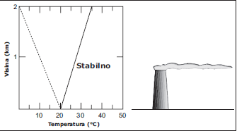
1.4 METEOROLOGICAL FACTORS
European Union IPA 2013 Programme for Croatia
The influence of atmospheric stability on the plume of smoke
fanning plume occurs under stable conditions in the atmosphere. Viewed from the side is a very thin shape with barely visible conical spread, while viewed from the top or bottom there is a form of flake extending from the top of the chimney. Since there is no atmospheric motion, the smoke spreads very slowly and because of the high chimney height it does not have to touch the ground for several kilometers. Often occurs in early morning during the temperature inversion.
fanning plume
STABLE
Altitude
Institut za energetiku i zaštitu okoliša
Temperature

Slide 52
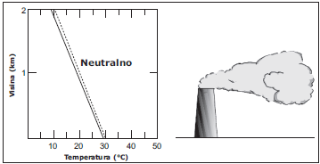
1.4 METEOROLOGICAL FACTORS
European Union IPA 2013 Programme for Croatia
The influence of atmospheric stability on the plume of smoke
coning plume is the basic shape of the smoke path under neutral and slightly unstable conditions. Such conditions occur for cloudy days. The smoke spreads as a chimney-shaped cone. Under such conditions, concentrations of pollutants in the air vary slightly.
coning plume
NEUTRAL
Altitude
Institut za energetiku i zaštitu okoliša
Temperature

Slide 53
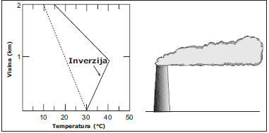
1.4 METEOROLOGICAL FACTORS
European Union IPA 2013 Programme for Croatia
The influence of atmospheric stability on the plume of smoke
lofting plume is created by releasing smoke into the atmosphere whose lower part is in inversion, and above it there is an unstable layer. Temperature inversion is a barrier to vertical air mixing which negatively affects the dispersion of pollutants.
lofting plume
INVERSION
Altitude
Temperature

Slide 54
1.4 METEOROLOGICAL FACTORS
European Union IPA 2013 Programme for Croatia
The influence of atmospheric stability on the plume of smoke
fumigating plume occurs when the inverse layer is above the smoke center and the unstable layer beneath it. As a result, the smoke is dispersed downward causing an increase in ground level concentrations of pollutants. A fumigating plume occurs every day when the night inversion begins to surface with the morning heat of the sun when the lower stable layer in less than one hour becomes very unstable.

Slide 55
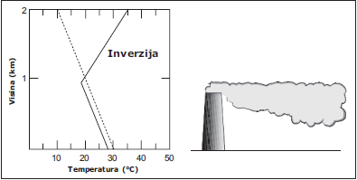
1.4 METEOROLOGICAL FACTORS
European Union IPA 2013 Programme for Croatia
The influence of atmospheric stability on the plume of smoke
In the case of increased cloudiness, the transition from stable to unstable, can last for hours, while maintaining increased high concentrations of pollutants at the Earth's surface.
fumigating plume
INVERSION
Altitude
Institut za energetiku i zaštitu okoliša
Temperature

Slide 56
1.4 METEOROLOGICAL FACTORS
European Union IPA 2013 Programme for Croatia
In the end we can conclude that knowledge of the underlying processes in the atmosphere is of utmost importance for making conclusions about transport and spread of pollutants in the air.

Slide 57
THANK YOU FOR YOUR ATTENTION !
Disclaimer: The contents of this publication are the sole responsibility of EKONERG – Energy Research and Environmental Protection Institute, Ltd. and can in no way be taken to reflect the views of the European Union
This project is funded by the European Union

